Slide 1

Embedded Learning
TRANSFORMERS
01-02-2025
By
Asha.M
Assistant professor
CSE(AI&ML)
KMIT

Slide 2
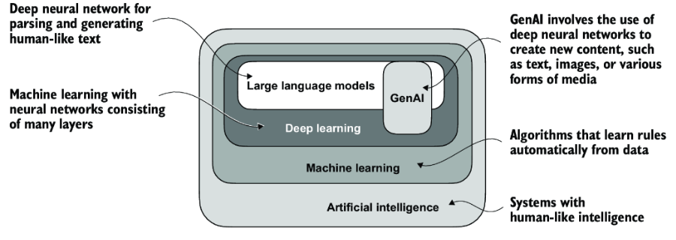

Slide 3
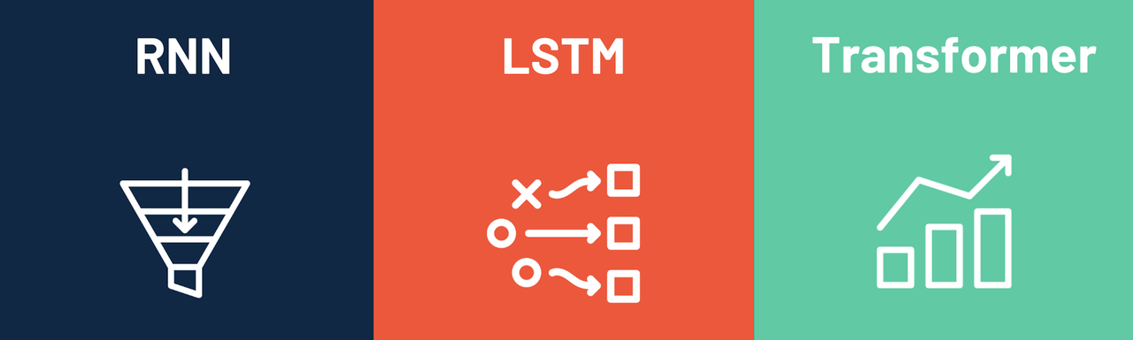

Slide 4
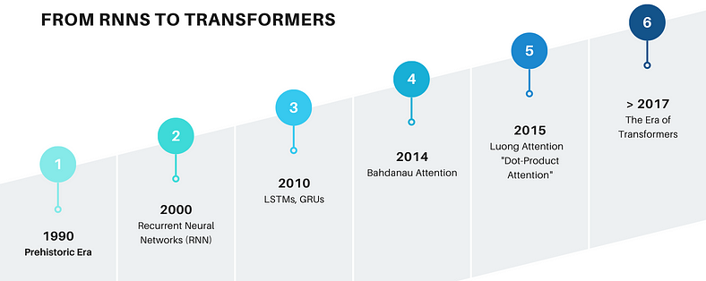

Slide 5


Slide 6
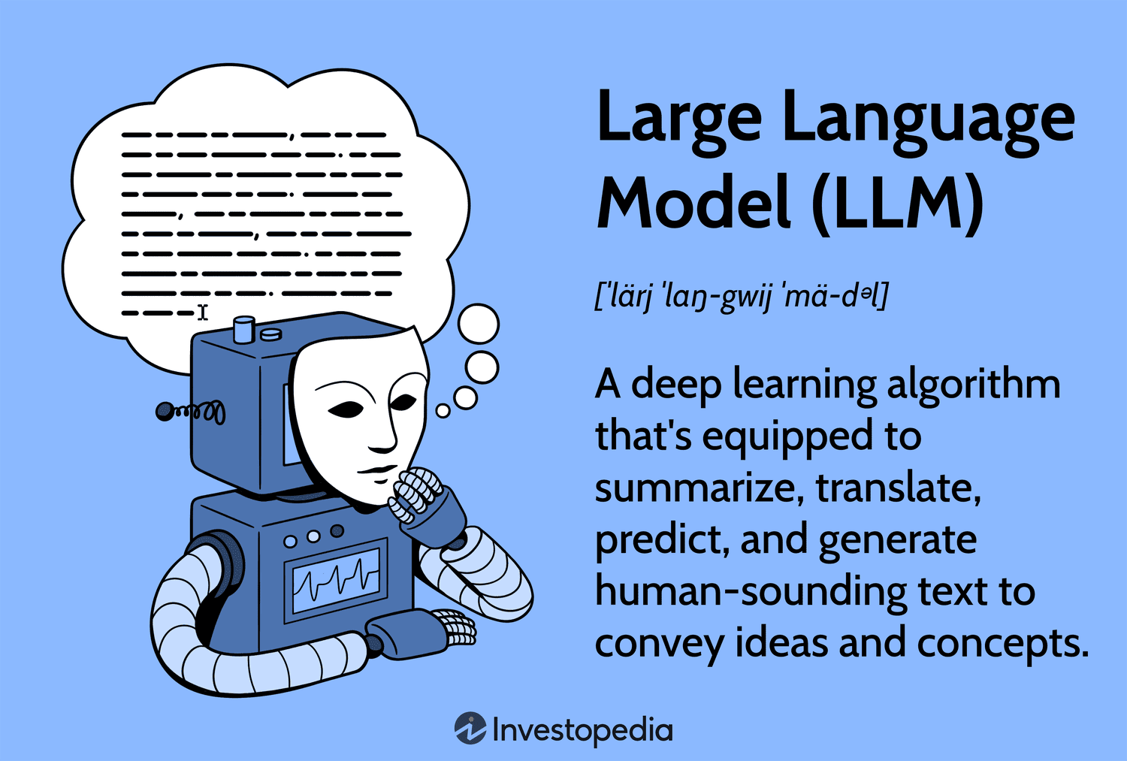

Slide 7
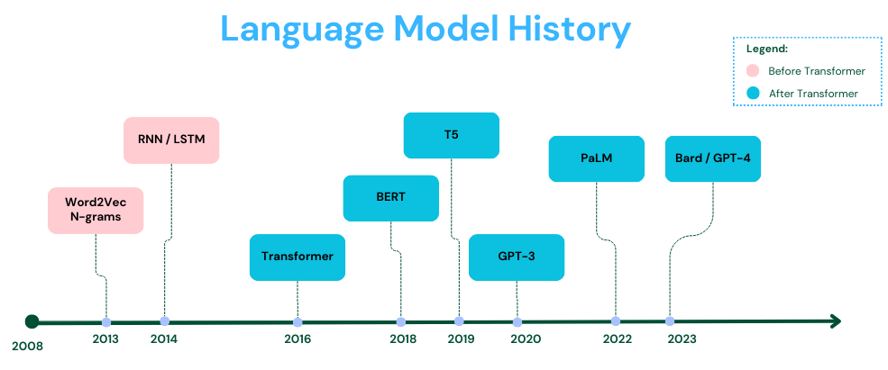

Slide 8
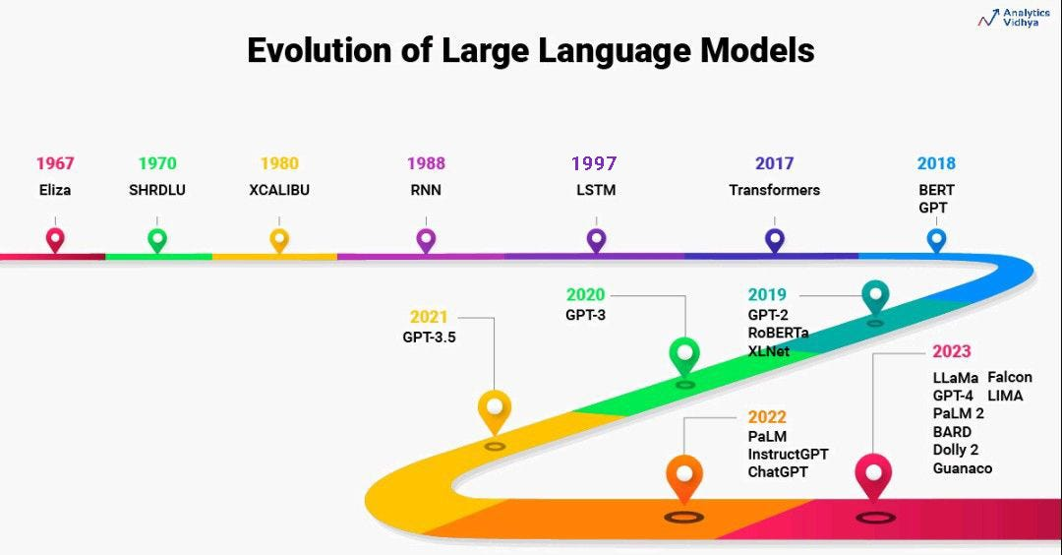

Slide 9
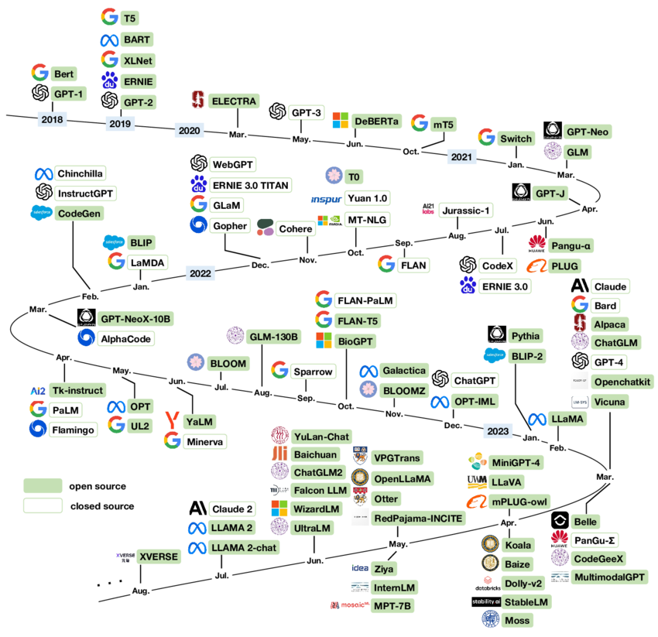

Slide 10
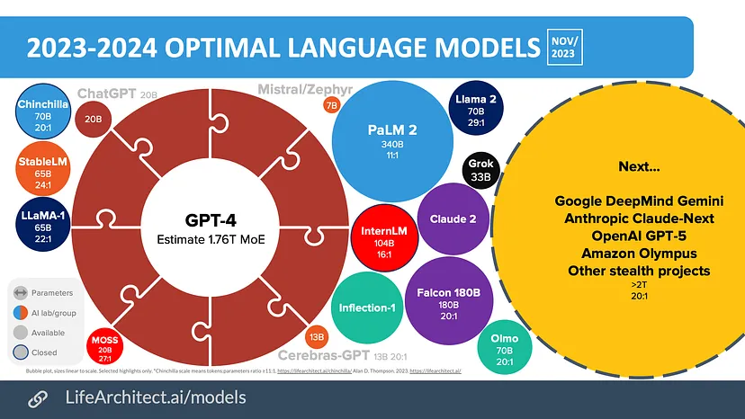

Slide 11
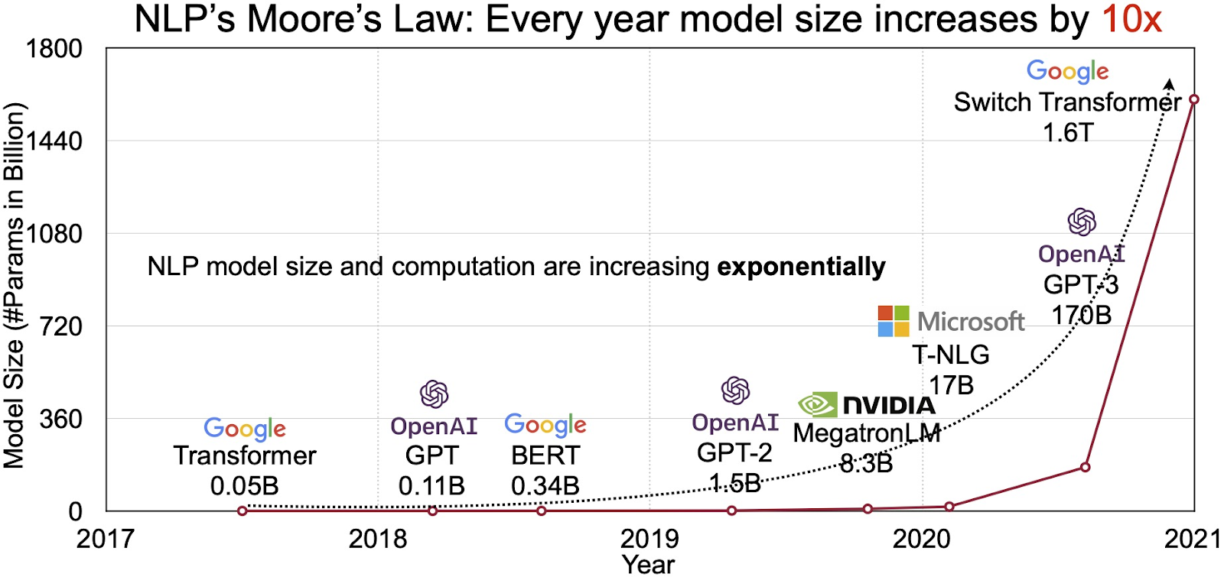

Slide 12
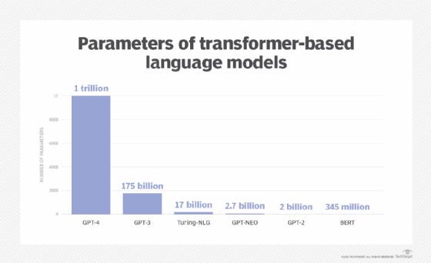

Slide 13
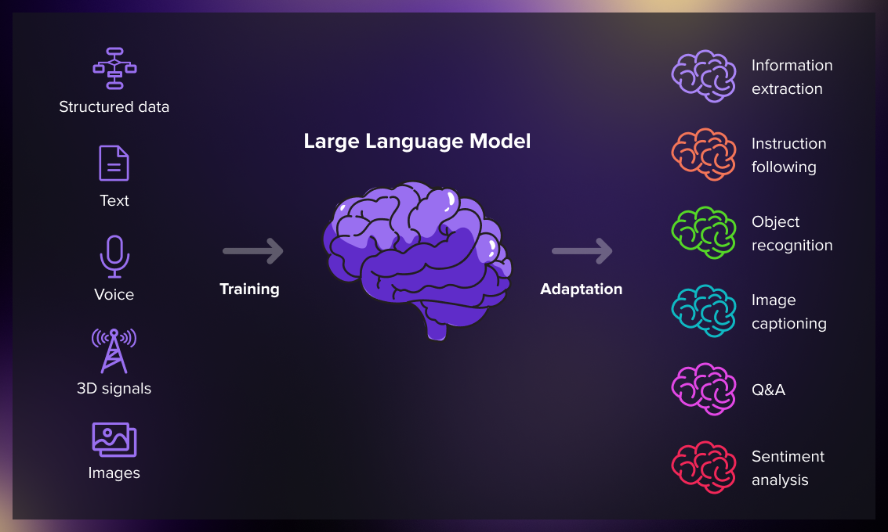

Slide 14
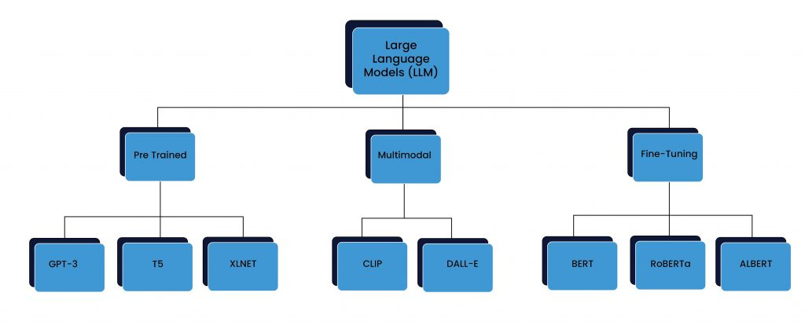

Slide 15
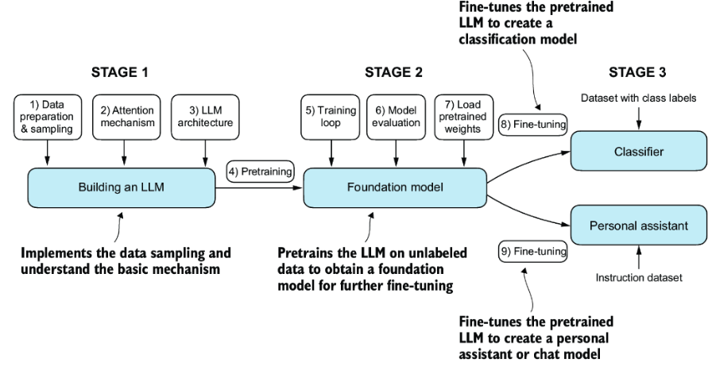

Slide 16
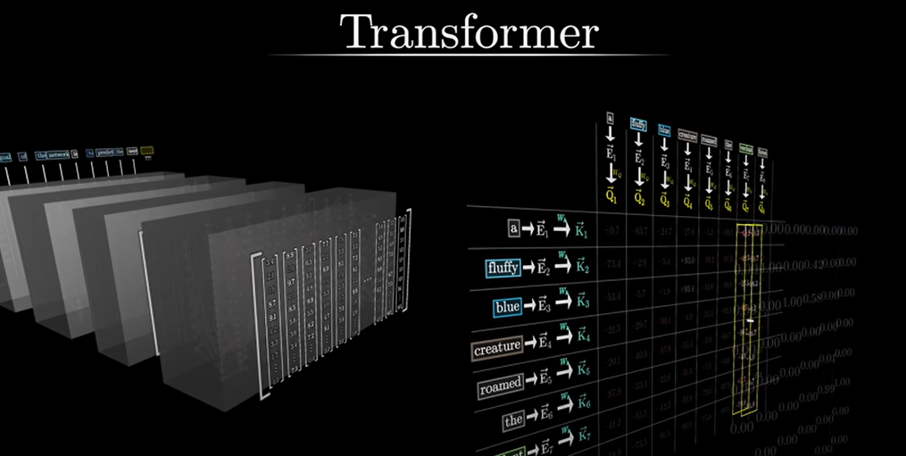

Slide 17
What is a Transformer?
A Transformer is a deep learning model introduced in "Attention Is All You Need" (Vaswani et al., 2017). It replaces recurrent layers (RNNs, LSTMs) with self-attention mechanisms, allowing for parallel processing and long-range dependencies.

Slide 18
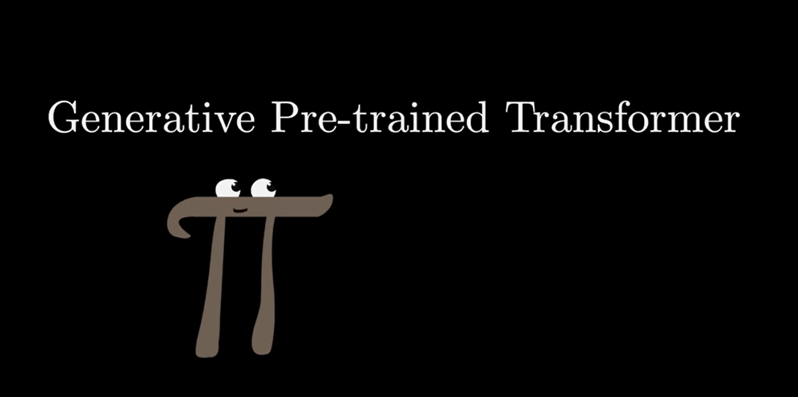

Slide 19

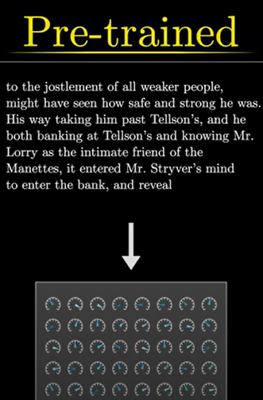
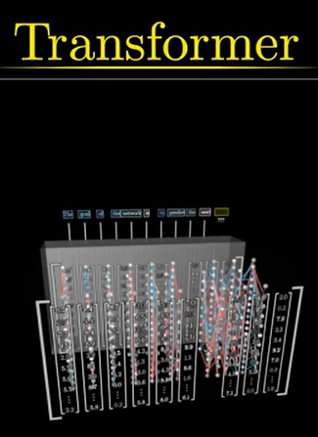
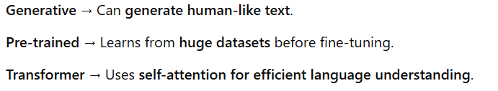

Slide 20
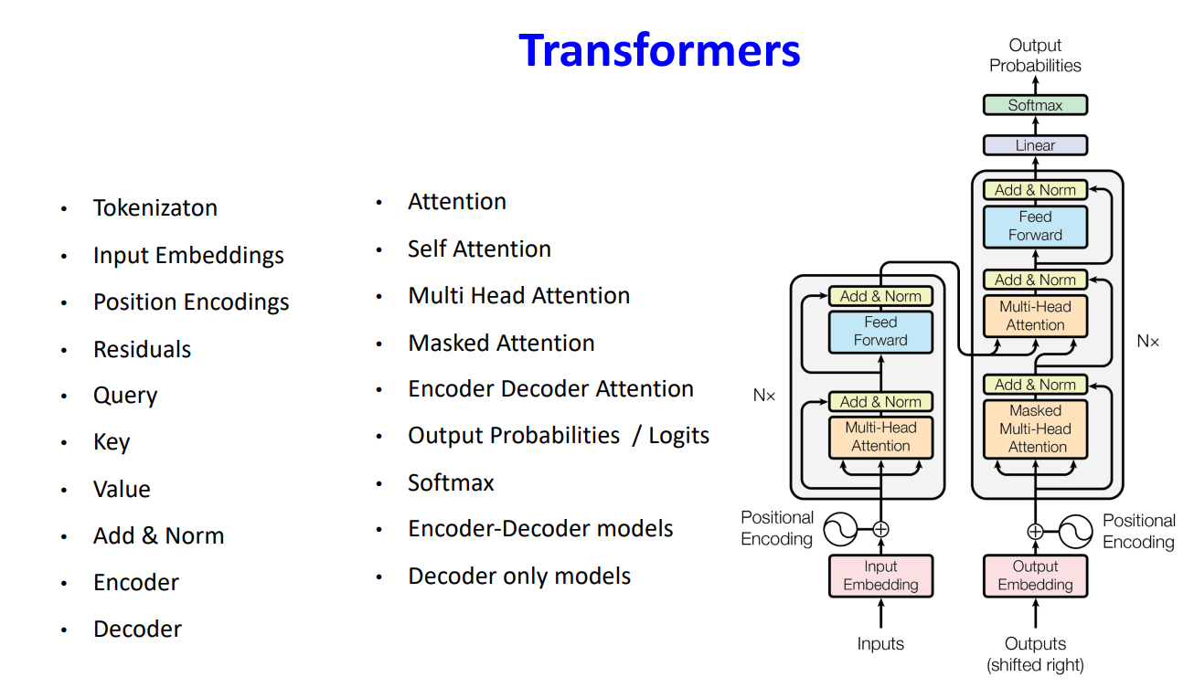

Slide 21
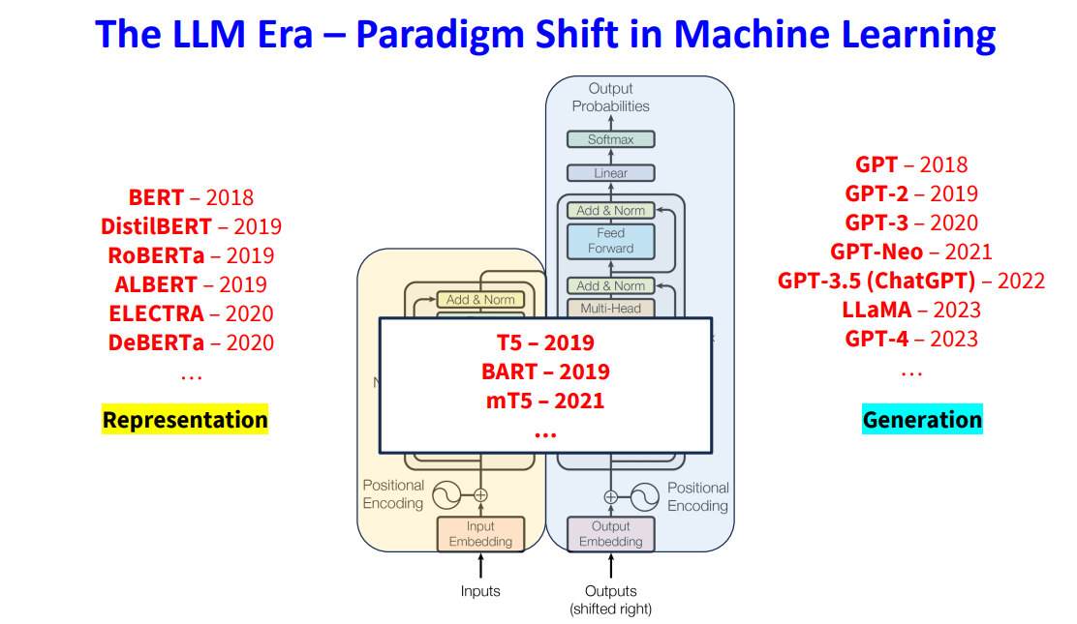

Slide 22
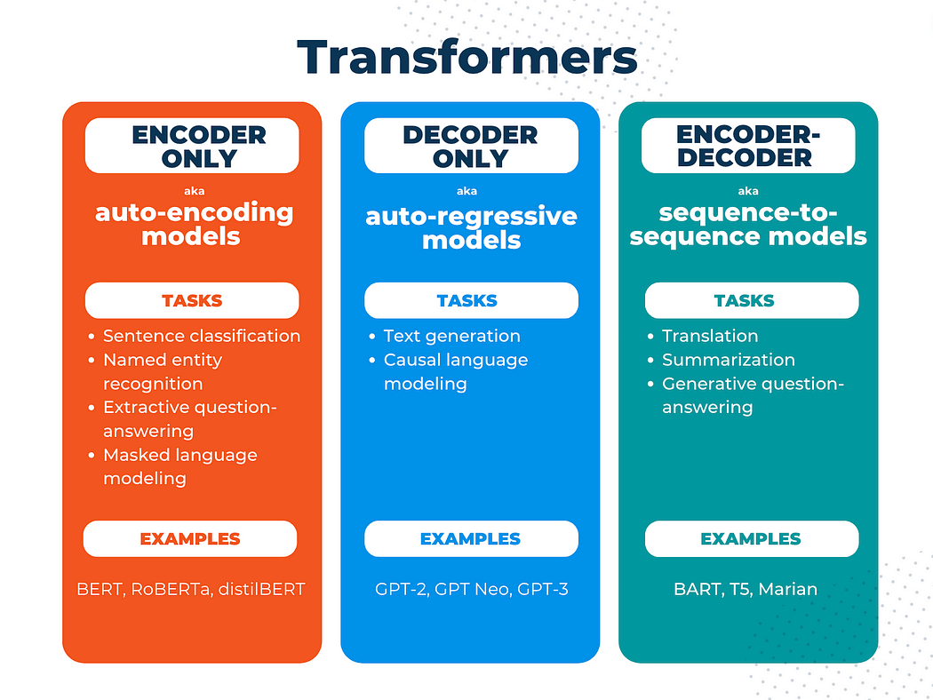

Slide 23
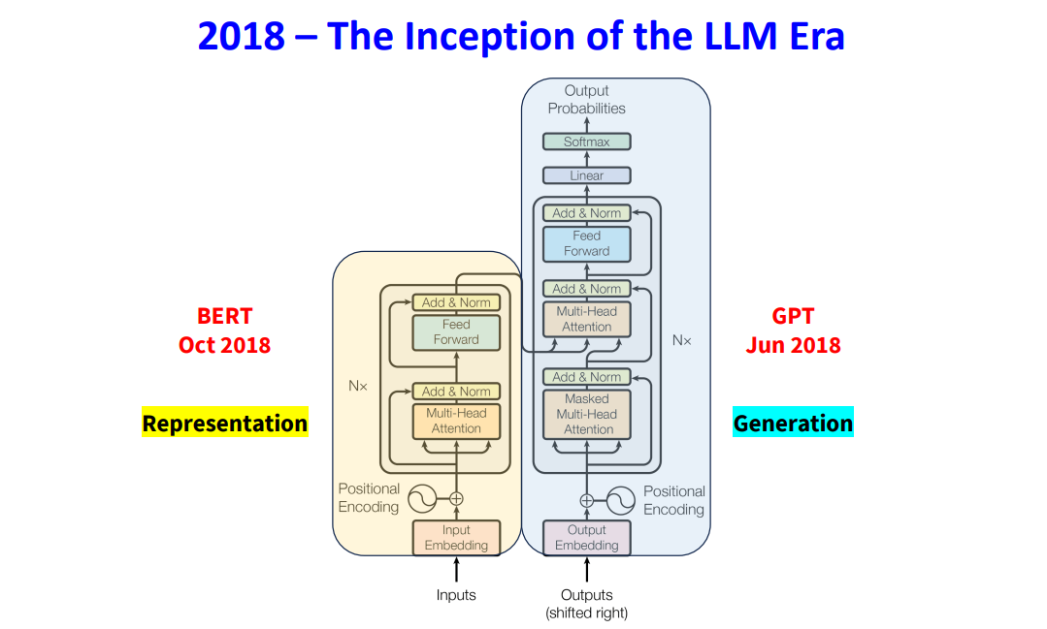

Slide 24
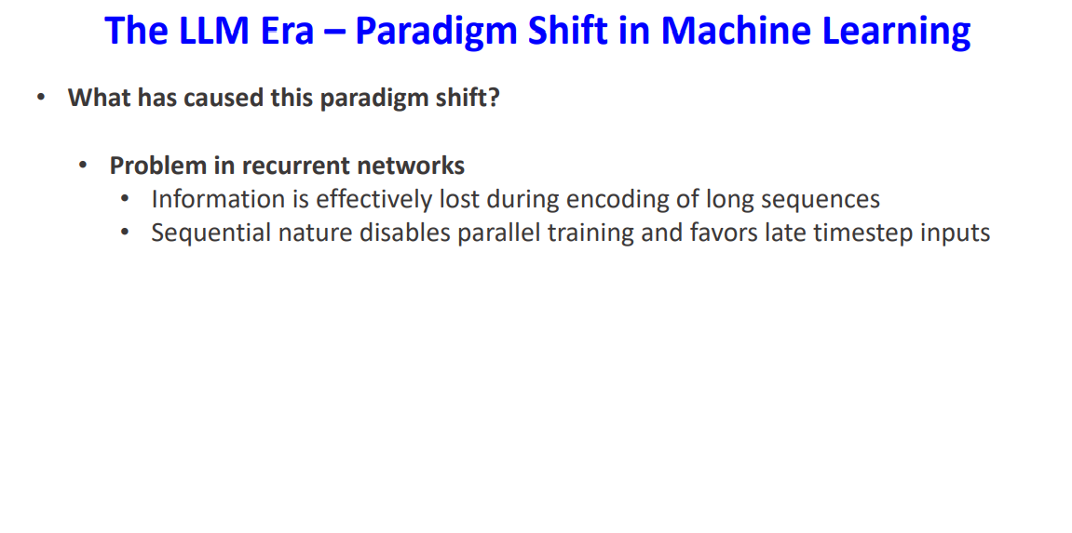

Slide 25
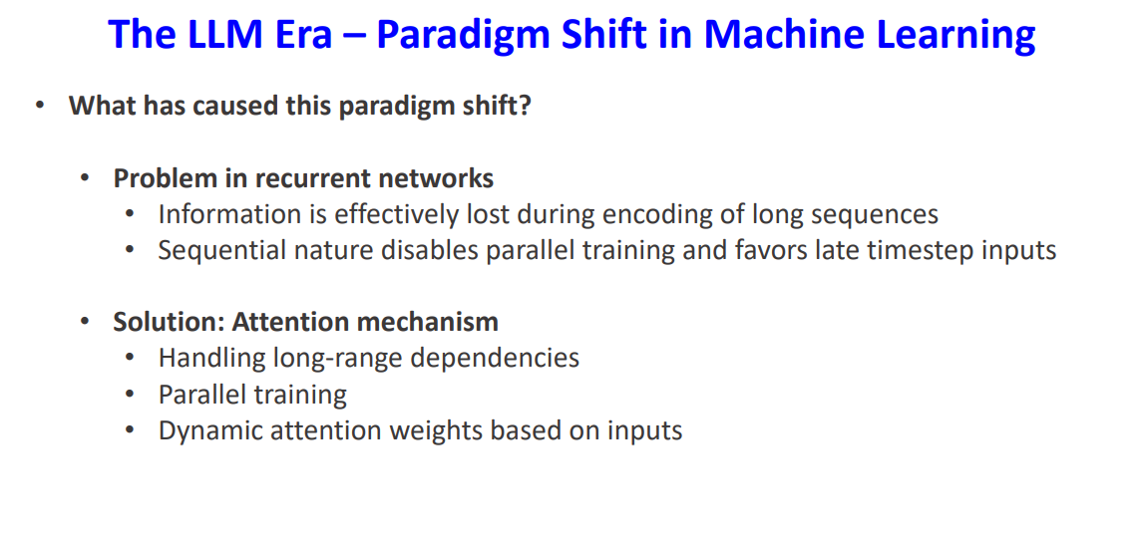

Slide 26
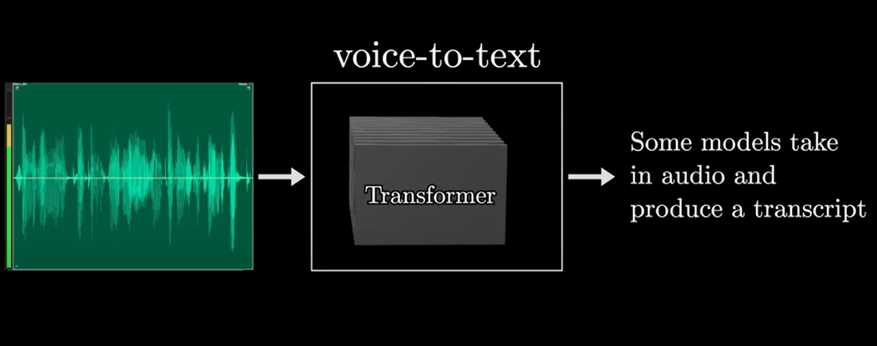

Slide 27
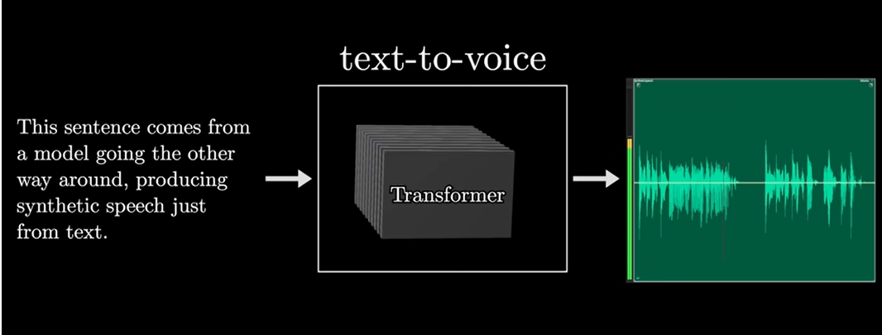

Slide 28
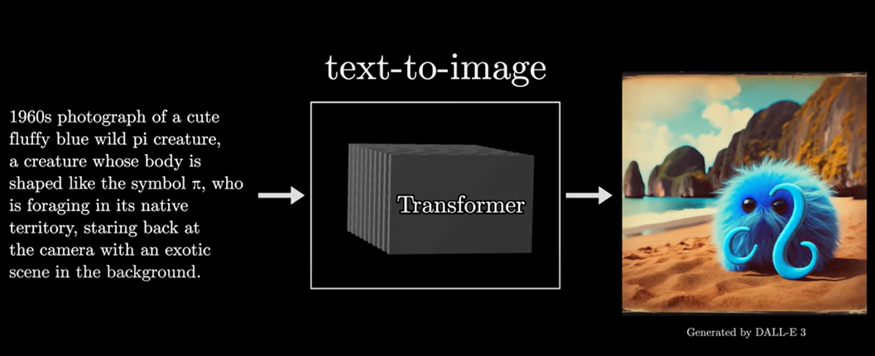

Slide 29
Recurrent Neural Networks
To increase the context available to our language model, we can use a recurrent neural network, a type of stateful NN. The network for each word maintains a state influenced by both the current word and previous hidden state. This architecture removes the fixes size of the context alleviating the problems of simpler neural language models.

Slide 30
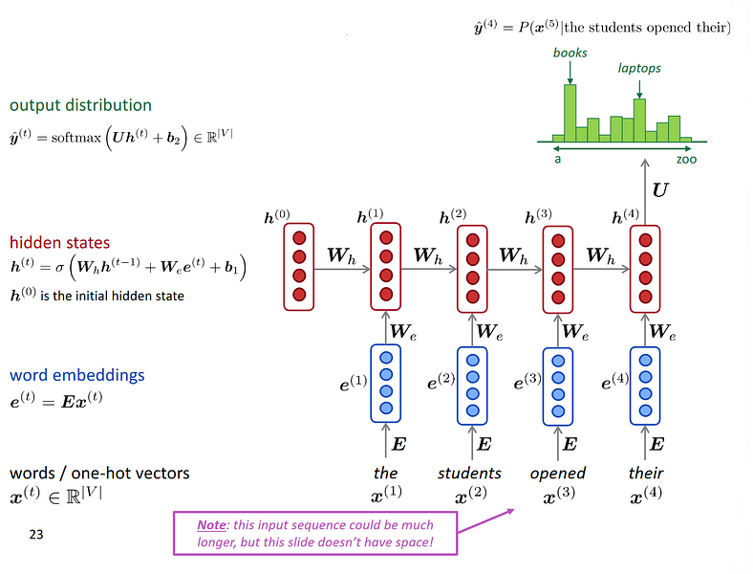

Slide 31
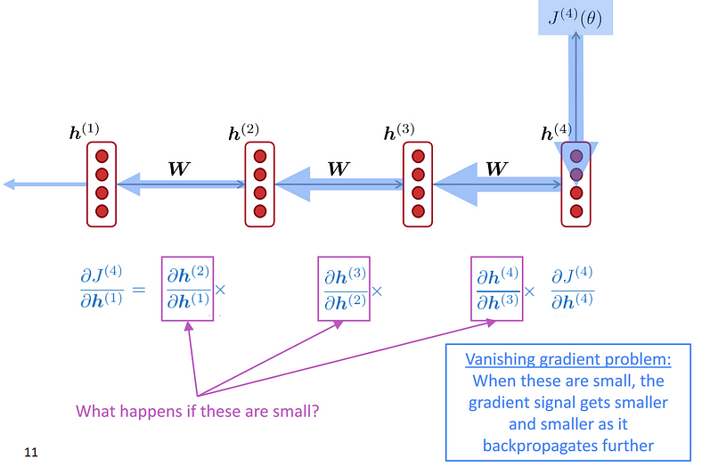

Slide 32
LSTM
One of the architecture proposed to solve the vanishing gradient problem is called Long Short-Term Memory, and it works by having both and hidden state and a memory cell and three gates the form read (in the hidden state), write and delete of the cell. They are called the output, input, and forget gate, respectively. This architecture implements a dedicated way to maintain long-term dependencies, which is never forgetting the memory cell.

Slide 33
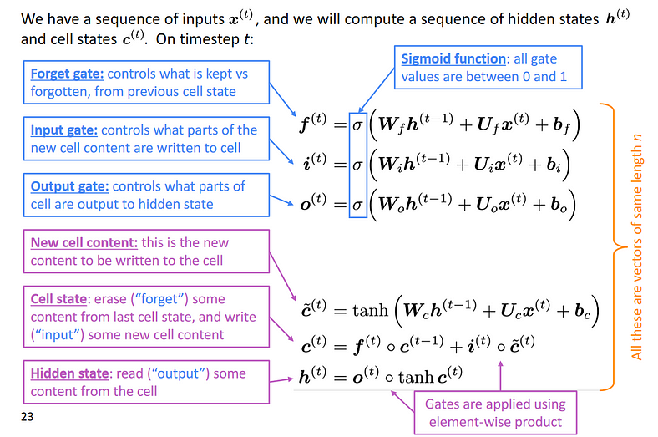

Slide 34
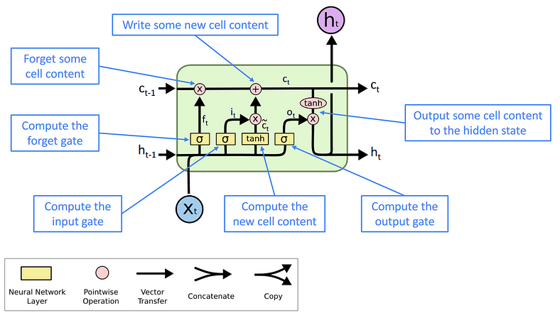

Slide 35
Seq2Seq (Sequence-to-Sequence) models are a type of neural network, an exceptional Recurrent Neural Network architecture, designed to transform one data sequence into another.
They are handy for tasks such as solving complex language problems like machine translation, question answering, creating chatbots, text summarization, etc.

Slide 36
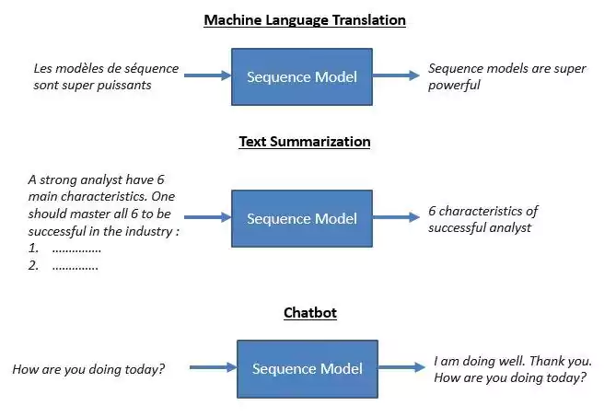

Slide 37
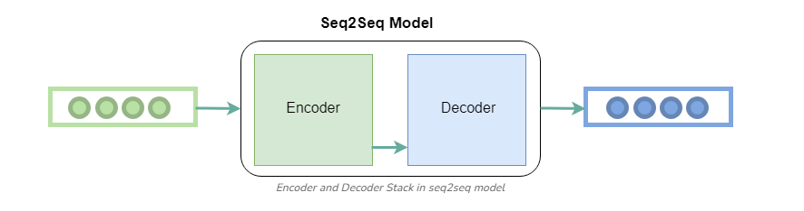
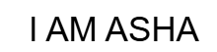
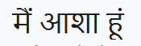

Slide 38
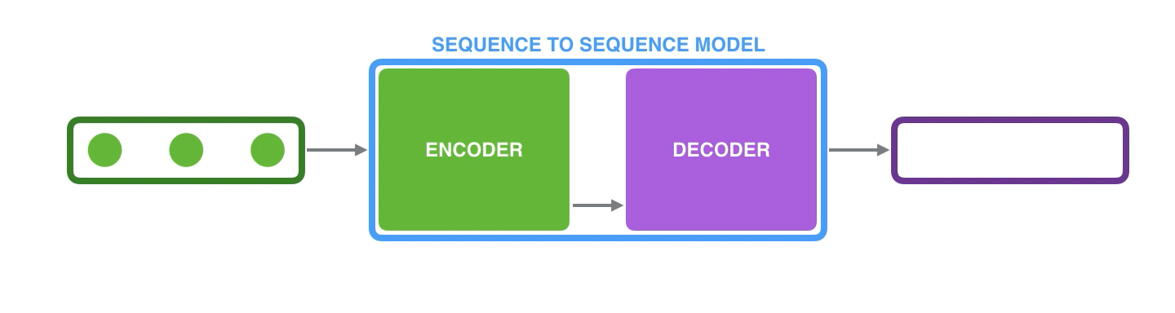
The model is composed of an encoder and a decoder.
The encoder processes each item in the input sequence, it compiles the information it captures into a vector (called the context). After processing the entire input sequence, the encoder sends the context over to the decoder, which begins producing the output sequence item by item.

Slide 39
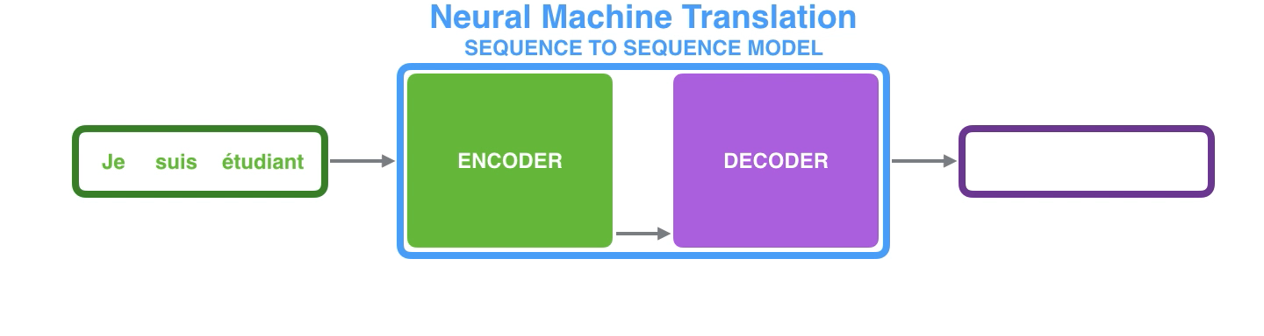
The context is a vector (an array of numbers, basically) in the case of machine translation. The encoder and decoder tend to both be recurrent neural networks

Slide 40
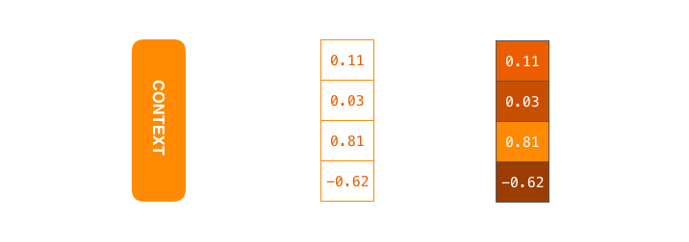

Slide 41
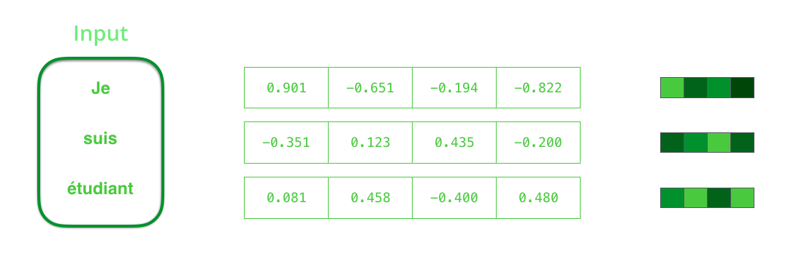
By design, a RNN takes two inputs at each time step: an input (in the case of the encoder, one word from the input sentence), and a hidden state. The word, however, needs to be represented by a vector. To transform a word into a vector, we turn to the class of methods called “word embedding” algorithms. These turn words into vector spaces that capture a lot of the meaning/semantic information of the words

Slide 42
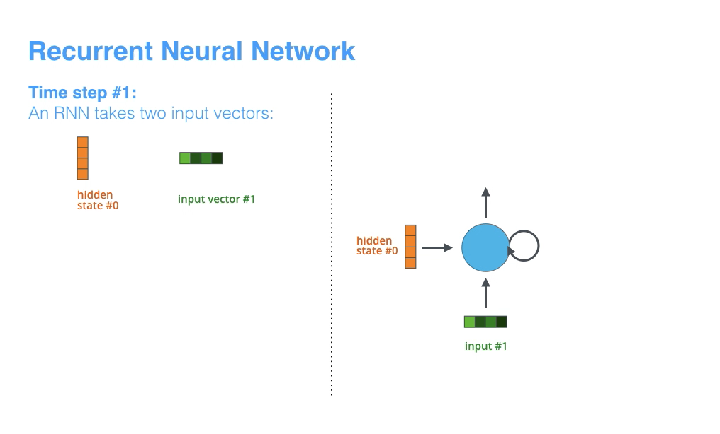

Slide 43
Each pulse for the encoder or decoder is that RNN processing its inputs and generating an output for that time step.
Since the encoder and decoder are both RNNs, each time step one of the RNNs does some processing, it updates its hidden state based on its inputs and previous inputs it has seen.

Slide 44
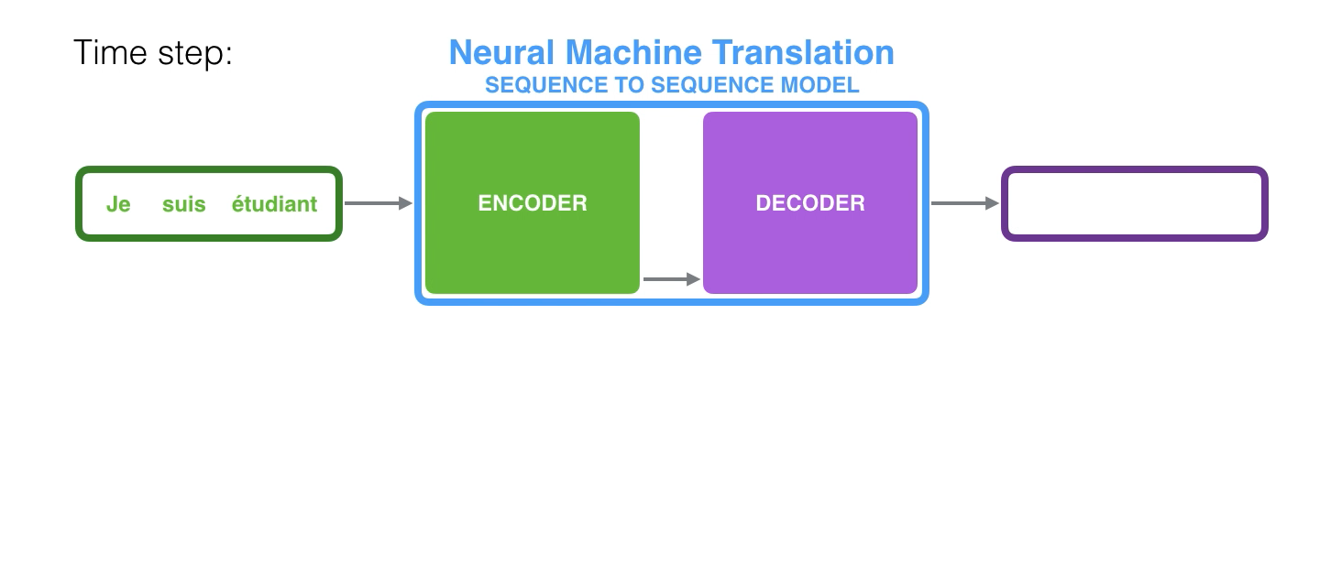
When we look at the hidden states for the encoder. Notice how the last hidden state is actually the context we pass along to the decoder.

Slide 45
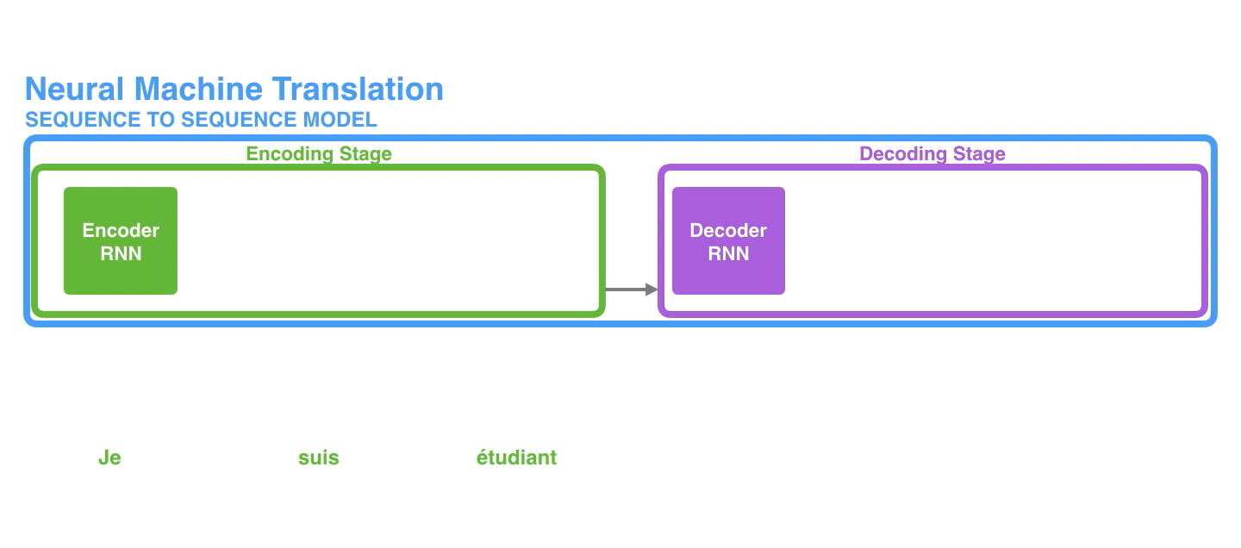
This is called an “unrolled” view where instead of showing the one decoder, we show a copy of it for each time step as we can look at the inputs and outputs of each time step.

Slide 46
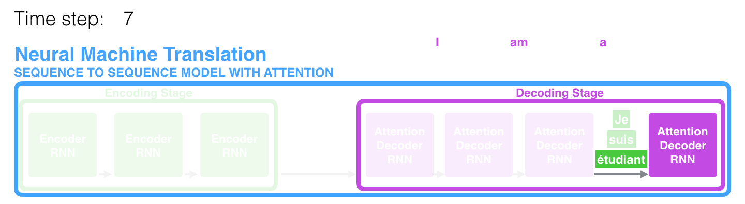
The context vector turned out to be a bottleneck for these types of models. It made it challenging for the models to deal with long sentences. A solution was proposed in Bahdanau et al., 2014 and Luong et al., 2015. These papers introduced and refined a technique called “Attention”, which highly improved the quality of machine translation systems. Attention allows the model to focus on the relevant parts of the input sequence as needed.

Slide 47
At time step 7, the attention mechanism enables the decoder to focus on the word "étudiant" ("student" in french) before it generates the English translation. This ability to amplify the signal from the relevant part of the input sequence makes attention models produce better results than models without attention.

Slide 48
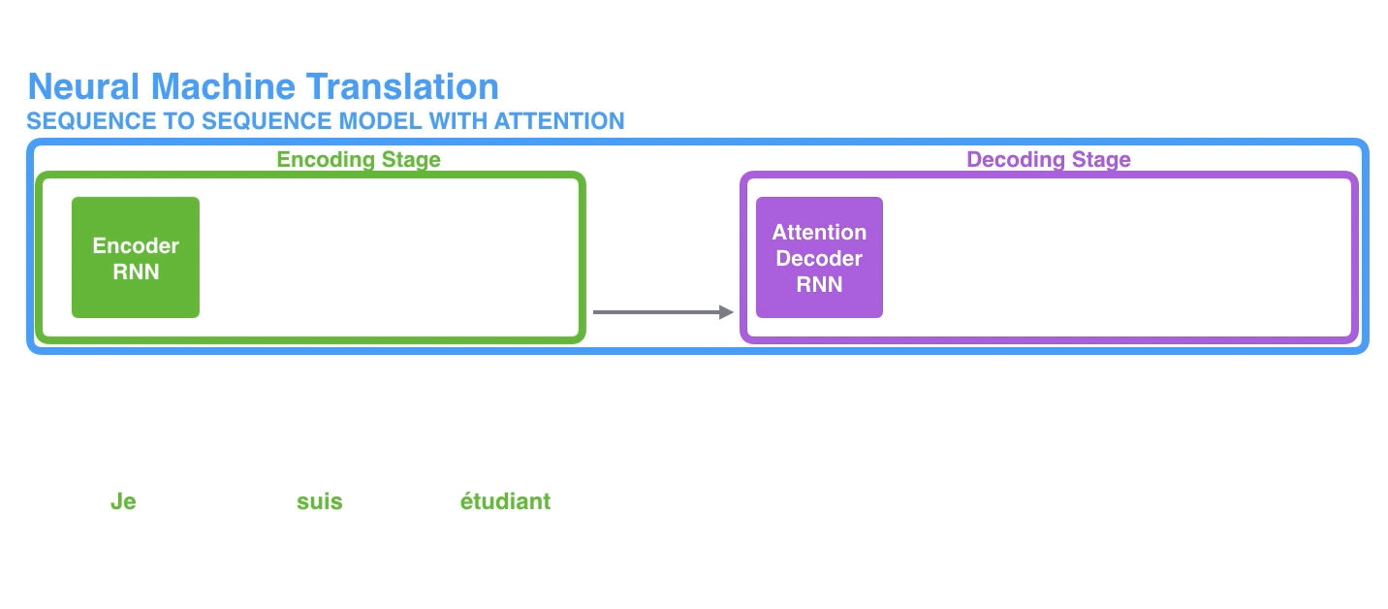

Slide 49
An attention model differs from a classic sequence-to-sequence model in two main ways:
First, the encoder passes a lot more data to the decoder. Instead of passing the last hidden state of the encoding stage, the encoder passes all the hidden states to the decoder
2) Second, an attention decoder does an extra step before producing its output. In order to focus on the parts of the input that are relevant to this decoding time step, the decoder does the following:
Look at the set of encoder hidden states it received – each encoder hidden state is most associated with a certain word in the input sentence
Give each hidden state a score (let’s ignore how the scoring is done for now)
Multiply each hidden state by its softmaxed score, thus amplifying hidden states with high scores, and drowning out hidden states with low scores

Slide 50
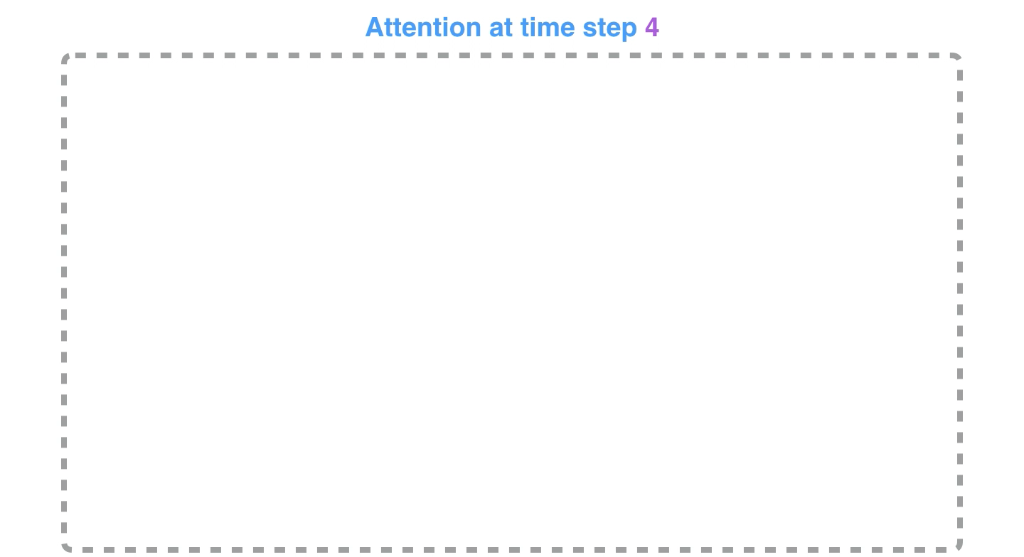

Slide 51
The attention decoder RNN takes in the embedding of the <END> token, and an initial decoder hidden state.
The RNN processes its inputs, producing an output and a new hidden state vector (h4). The output is discarded.
Attention Step: We use the encoder hidden states and the h4 vector to calculate a context vector (C4) for this time step.
We concatenate h4 and C4 into one vector.
We pass this vector through a feedforward neural network (one trained jointly with the model).
The output of the feedforward neural networks indicates the output word of this time step.
Repeat for the next time steps

Slide 52
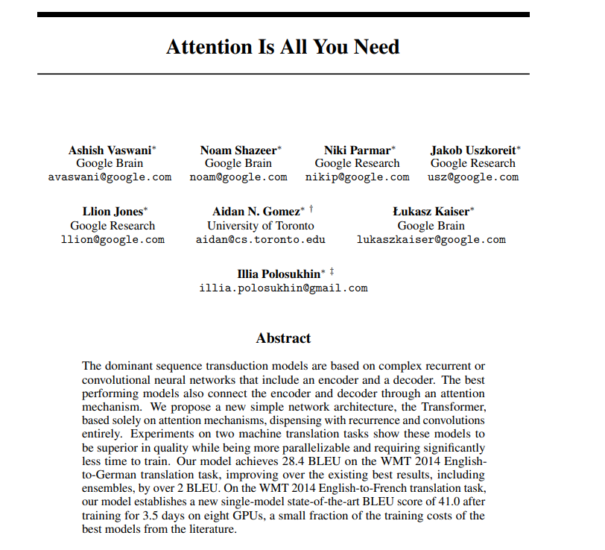

Slide 53
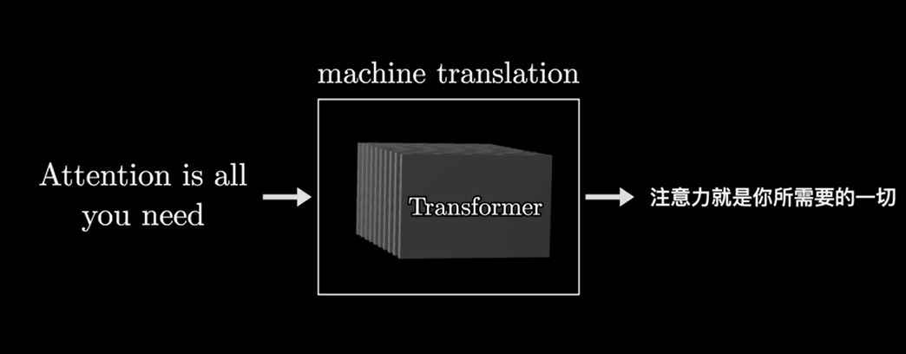

Slide 54
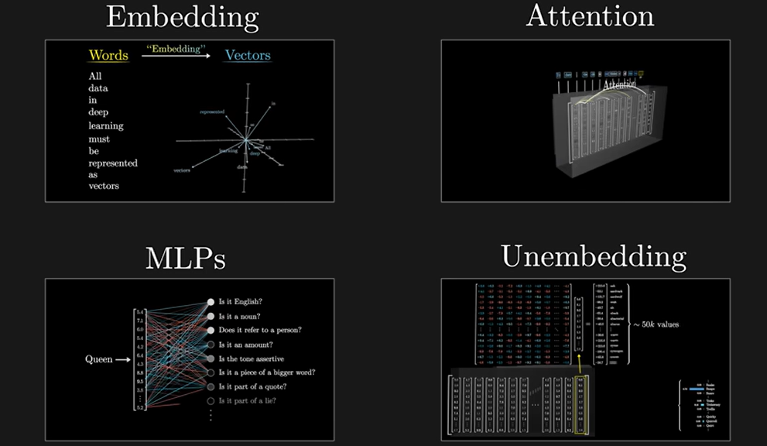

Slide 55
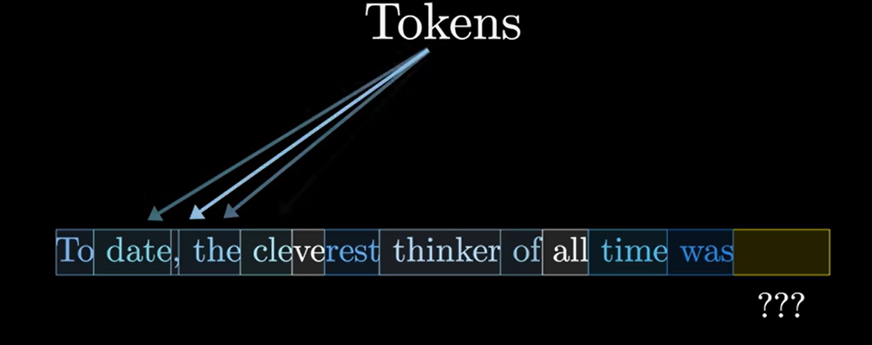


Slide 56
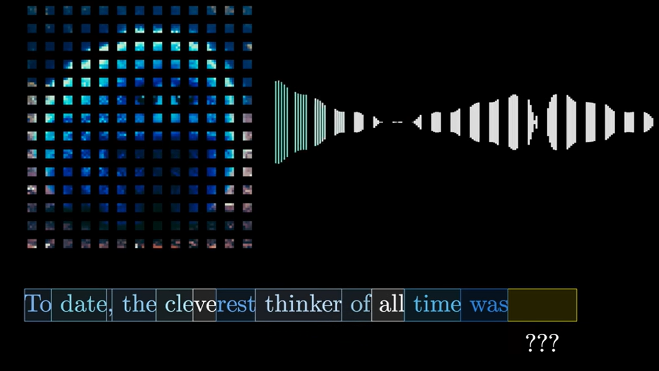


Slide 57


Slide 58


Slide 59



Slide 60


Slide 61


Slide 62
Attention Mechanism
Assign attention weight to each word, to know how much "attention" the model should pay to each word (i.e., for each word, the network learns a "context")

Slide 63


Slide 64


Slide 65


Slide 66


Slide 67


Slide 68


Slide 70

The original transformer published in the paper is a neural machine translation model. For example, we can train it to translate English into French sentences.

Slide 71

The transformer uses an encoder-decoder architecture. The encoder extracts features from an input sentence, and the decoder uses the features to produce an output sentence (translation).

Slide 72

The encoder in the transformer consists of multiple encoder blocks. An input sentence goes through the encoder blocks, and the output of the last encoder block becomes the input features to the decoder.

Slide 73

The decoder also consists of multiple decoder blocks.

Slide 74

Each decoder block receives the features from the encoder. If we draw the encoder and the decoder vertically, the whole picture looks like the diagram from the paper.

Slide 75

Input Embedding and Positional Encoding
Like any neural translation model, we often tokenize an input sentence into distinct elements (tokens). A tokenized sentence is a fixed-length sequence.

Slide 76
with the transformer, we inject positional encoding into each embedding so that the model can know word positions without recurrence.
The input to the transformer is not the characters of the input text but a sequence of embedding vectors.
Each vector represents the semantics and position of a token. The encoder performs linear algebra operations on those vectors to extract the contexts for each token from the entire sentence and enrich the embedding vectors with helpful information for the target task through the multiple encoder blocks.

Slide 77

Softmax and Output Probabilities
The decoder uses input features from the encoder to generate an output sentence. The input features are nothing but enriched embedding vectors.

Slide 78
The decoder outputs one token at a time. An output token becomes the subsequent input to the decoder. In other words, a previous output from the decoder becomes the last part of the next input to the decoder. This kind of processing is called “auto-regressive” — a typical pattern for generating sequential outputs and not specific to the transformer. It allows a model to generate an output sentence of different lengths than the input.

Slide 79

However, we have no previous output at the beginning of a translation. So, we pass the start-of-sentence marker <SOS> to the decoder to initiate the translation.

Slide 80
The decoder uses multiple decoder blocks to enrich <SOS> with the contextual information from the input features. In other words, the decoder transforms the embedding vector <SOS> into a vector containing information helpful to generating the first translated word (token).
Then, the output vector from the decoder goes through a linear transformation that changes the dimension of the vector from the embedding vector size (512) into the size of vocabulary (say, 10,000). The softmax layer further converts the vector into 10,000 probabilities.

Slide 81


Slide 82


Slide 83

Encoder Block Internals
The encoder block uses the self-attention mechanism to enrich each token (embedding vector) with contextual information from the whole sentence.

Slide 84

The position-wise feed-forward network (FFN) has a linear layer, ReLU, and another linear layer, which processes each embedding vector independently with identical weights. So, each embedding vector (with contextual information from the multi-head attention) goes through the position-wise feed-forward layer for further transformation.

Slide 85

Residual connections carry over the previous embeddings to the subsequent layers. As such, the encoder blocks enrich the embedding vectors with additional information obtained from the multi-head self-attention calculations and position-wise feed-forward networks.

Slide 86

After each residual connection, there is a layer normalization:

Slide 87
Like batch normalization, layer normalization aims to reduce the effect of covariant shift.
In other words, it prevents the mean and standard deviation of embedding vector elements from moving around, which makes training unstable and slow (i.e., we can’t make the learning rate big enough).
Unlike batch normalization, layer normalization works at each embedding vector (not at the batch level).

Slide 88

The transformer uses six stacked encoder blocks. The outputs from the last encoder block become the input features for the decoder.

Slide 89

Decoder Block Internals
The decoder block is similar to the encoder block, except it calculates the source-target attention.

Slide 90
The input to the decoder is an output shifted right, which becomes a sequence of embeddings with positional encoding. So, we can think of the decoder block as another encoder generating enriched embeddings useful for translation outputs.
Masked multi-head attention means the multi-head attention receives inputs with masks so that the attention mechanism does not use information from the hidden (masked) positions. The paper mentions that they used the mask inside the attention calculation by setting attention scores to negative infinity (or a very large negative number). The softmax within the attention mechanisms effectively assigns zero probability to masked positions.

Slide 91


Slide 92


Slide 93



Slide 94


Slide 95


Slide 96


Slide 97


Slide 98


Slide 99


Slide 100


Slide 101


Slide 102


Slide 103


Slide 104


Slide 105


Slide 106


Slide 107


Slide 108


Slide 109


Slide 110


Slide 111


Slide 112


Slide 113


Slide 114



Slide 115


Slide 116


Slide 117


Slide 118


Slide 119


Slide 120


Slide 122


Slide 123


Slide 124


Slide 125


Slide 126


Slide 127


Slide 128



Slide 129



Slide 130


Slide 131


Slide 132



Slide 133


Slide 134


Slide 135


Slide 137


Slide 138



Slide 139


Slide 140


Slide 141


Slide 142


Slide 143



Slide 144


Slide 145


Slide 146


Slide 147


Slide 148


